Slide 1
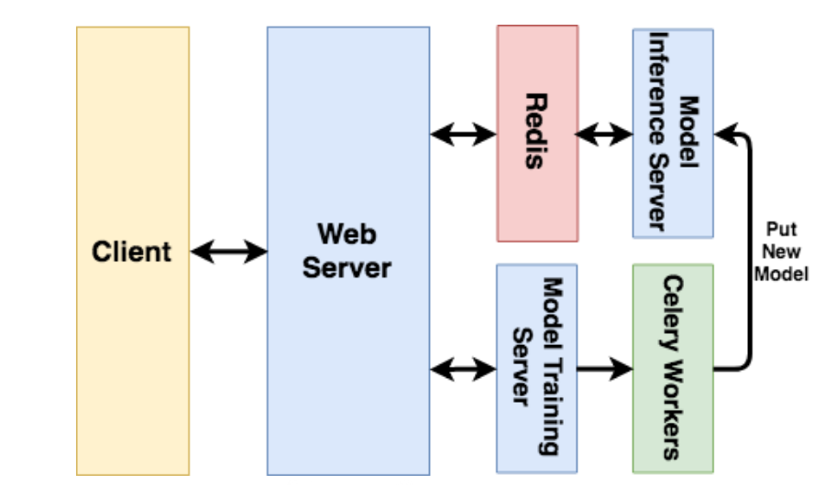

Slide 2
 | symptom | reasoning | cause
project_mvp
 | elb not responding to url req | didn’t set up security group | reasoning is correct; also needed to setup health checks
project_fff
 | site can't be reached | port not open | port to server not in security group; useful command: netstat -tlpn
 | timeout - last error: dial tcp :22: connect: connection refused | port not correct | provisioner don’t work inside aws_launch_configuration; use user_data
 |  |  | port not correct; instance_sg should allow ingress on port 22 as well as the same port that application runs on, and elb should direct to that port
 | could not retrieve mirrorlist http //repo.us-west-2.amazonaws.com/latest/main/mirror.list | healthy checks failing | no egress on instance_sg

